Slide 1
7th European Summit of Regions and Cities
8-9 July2016
Department of Strategy, Regional Development and Project Management

Slide 2
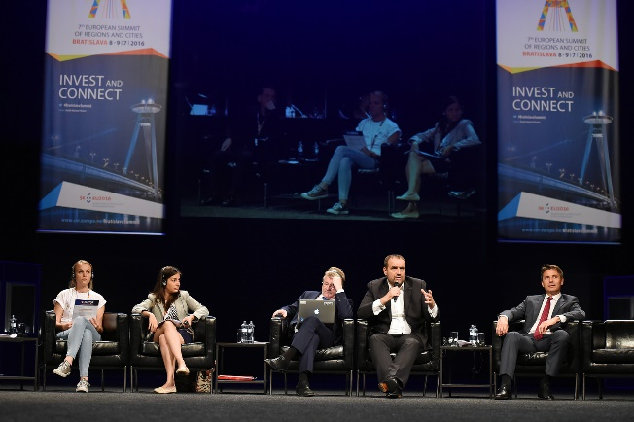
7th European Summit of Regions and Cities
Organisers:
Bratislava Region
City of Bratislava
European Committee of the Regions
One of the biggest events of SK PRES 2016
Main topics: strengthening investments in Europe, simplification of the EU Cohesion Policy
Motto: „Invest and Connect“

Slide 3
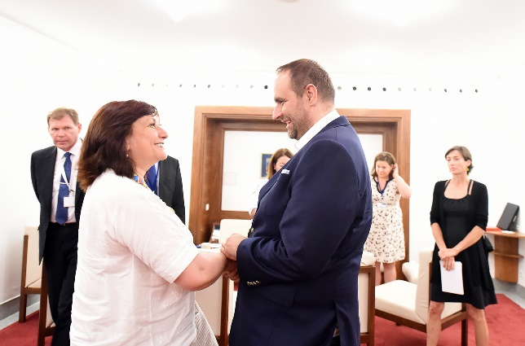
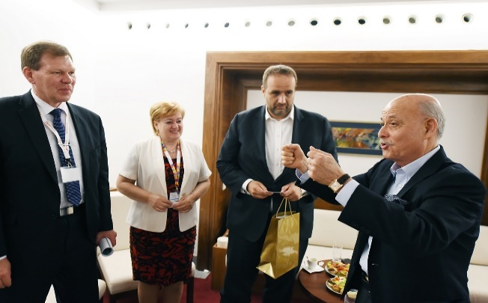
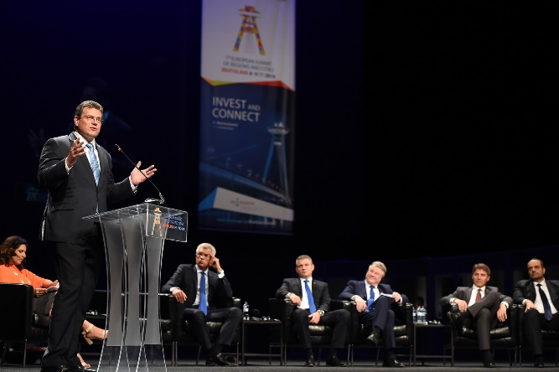
High level speakers
Jeremy Rifkin
Jyrki Katainen
Violeta Bulc
Maroš Šefčovič
Peter Pellegrini
László Baranyay
Dirk Ahlborn
Vladimír Šucha
Markku Markkula
Iskra Mihaylova etc.

Slide 4
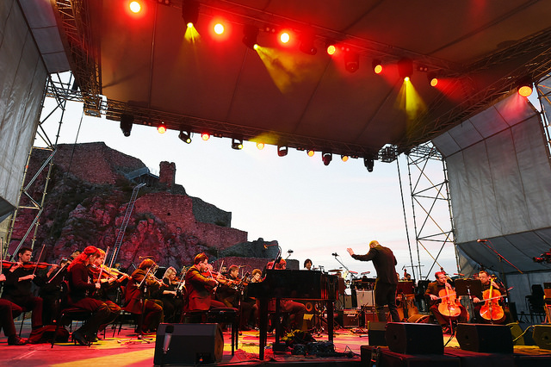
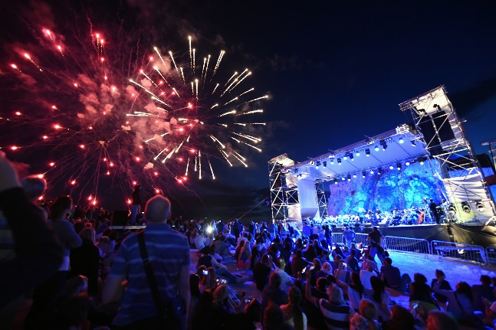
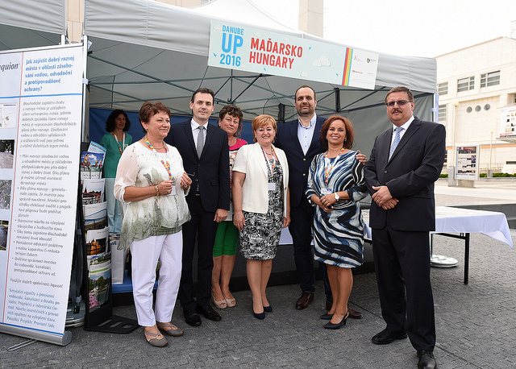
Summit open to the public
Opening concert at Devin Castle
DANUBE UP 2016
Danube regions presented their water-related startups and tourism
Cultural programme
Programme for families with children
Y-Factor
Public debates

Slide 5
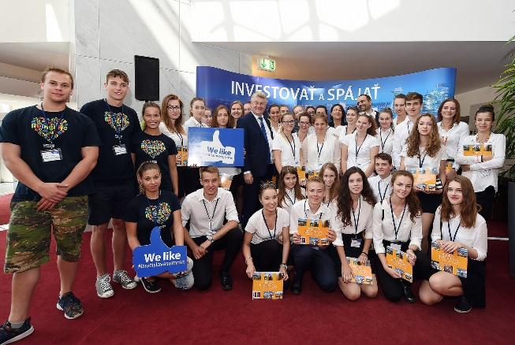
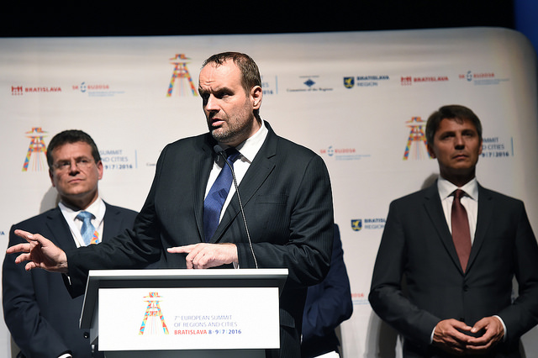
Outcomes and figures
More than 1000 participants from around Europe
41 speakers in 10 discussion panels
70 journalists from 20 countries
10000+ visitors of the public events
Dozens of bilateral meetings, networking, building of partnerships
Bratislava Declaration: document adopted by the local and regional leaders calling on the EU to improve regulation and attract greater private-public investment to create more jobs and tackle the investment gap.
Involvement of high school students (creation of the logo, exhibitions, cultural programme, hostesses, catering etc.)
„Touristic excursion“ for the participants

Slide 6
Department of Strategy, Regional Development and Project Management Sabinovská 16, P.O.Box 106 820 05 Bratislava 25 martin.hakel@region-bsk.sk www.bratislavskykraj.sk www.bratislavaregion.eu
Thank you for your attention!

