Slide 1
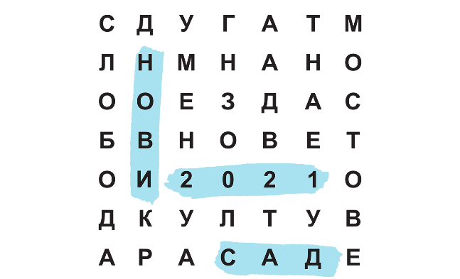
Novi Sad 2021
Danube Promenade
Notes:
It is using the background from https://dribbble.com/shots/1588545--Freebie-7-Low-Poly-Backgrounds-svg-png
Template modified by fppt.com

Slide 2
Basic premise
the idea is that on certain locations the bank of the Danube could be utilized as a form of public space to promote cultural events and creative industries along the Danube river, which would create bonds between the inhabitants and introduce each other’s art and cultural heritage.
Notes:
It is using the background from https://dribbble.com/shots/1588545--Freebie-7-Low-Poly-Backgrounds-svg-png
Template modified by fppt.com

Slide 3
Core concept
The “core” of the concept is the creation of “interactive open-air galleries” as landmark spots for exhibiting and promoting cultural elements of the local areas.
Open spaces of the landmarks will be suitable for supporting concerts, exhibitions, contemporary and traditional artistic presentations etc., following the thematic schedule.
Notes:
It is using the background from https://dribbble.com/shots/1588545--Freebie-7-Low-Poly-Backgrounds-svg-png
Template modified by fppt.com

Slide 4
Content
All landmarks will have two big screens, presenting A-V material serving informative, recreational, educational and observing purposes, in relation to all participant areas.
The screens can be considered as terminal observation spots that provide the visitors the chance to view selected territorial pictures and maps, historical, statistical and market information about the Danube Region and the participant cities etc.

Slide 5
Content
On one side, there will be a reproduction of the material shown in the big screens, while on the other side, there will be another screen giving the opportunity to the users to virtually navigate through suggested Danube Region Routes, watch videos about certain areas, traditional customs, products and professions, alongside with having access to useful contemporary information, about products, services and landmarks/sights of the areas.

Slide 6
Relevance
The strategic relevance of the project comes from the fact that the Danube region still faces historic complexities and transitional challenges related to culture, local heritage and social structures. The project will tackle these challenges through workshops, building the capacities of local cultural actors and through designing common methodologies to rethink local potentials and open up new spaces for upcoming artists as well as to foster the exchange of knowledge of each other’s cultural heritage

Slide 7
Partnership
Partners’ capacity should guarantee not only the proper implementation but also the sustainability of the project. Regarding the quality characteristics, the preferred partners should be:
Situated by the Danube river, with a rather developed coastline area (e.g. Novi Sad, Linz, Ulm)
Local and Regional Administration/Self-Administration Authorities
Local and Regional Culture and/or Tourism Development Agencies / Associations / Organizations
Museums, Art Galleries / Foundations / Institutes etc
Creative industry entities

Slide 8
Specific objectives
To enhance exchange, availability and accessibility of relevant data and info
To improve cooperation between decision makers, providers, visitors and local populations
To encourage synergies in order to achieve extroversion
To introduce digital solutions in order to educate the population in the Danube region
To represent local and less known local artist in order to foster multiculturalism, cultural exchange and cultural diversity
To establish pilot artistic solutions that can be transferred to other cities in order to foster sustainable touristic and cultural development

Slide 9
Specific objectives cont.
To promote and develop the joint marketing of cross-border tourism products and transnational thematic itineraries (e.g. cultural, religious, ancient trade routes, etc.)
To promote historical heritage and support its preservation through sustainable tourism development and destination branding (e.g. small-scale infrastructure works, marketing)
To jointly promote cultural products (handicrafts, artworks, etc.) and events (festivals, fairs)
To encourage networking, share good experience in strengthening cultural and creative industries (music, multimedia, etc.)

Slide 10
Thank you for your attention
Our website: www.novisad2021.rs
Contact us: international@ns2021.rs

