Slide 4
.
Together through art and culture (Platform FUSE)
The aim of the project is the social inclusions and involvement of the Roma and Turkish communities, as well as the creation of active cultural community projects in Stolipinovo district.
The strategy for the development of the project includes the exchange of experience, the active inclusion of the marginalized groups, overcoming the differences and the invisible borders and implementing awareness-raising initiatives. The aim of the project is to achieve a long-term results and effects, overcoming the stereotypes in the mass perception of the neighbourhood and the community, gaining different experiences in communicating with it and creating lasting opportunities for realization of the talents and the potential of the children and the young people from the community. The activities that had already happened comprise of anthropological mapping of the neighbourhood and an international workshop for development of temporary interventions. Forthcoming is the publishing of a unique for Bulgaria research book, in Bulgarian language, for the life of the Roma community, as well as a digital guide, in English language, outlining the basic guidelines for work and artistic interactions with the community.
This is the project cluster registering the biggest international interest on behalf of partner organizations and individual artist, as well as the one which is most closely monitored by the international panel of the European commission. The main projects which will be implemented within its frame are in the filed performative arts – music, dance, theatre, as well as education and creative work with adolescents and their families.
Some of the main project partners: French Cultural Institute Sofia, Youth Club Roma, ATD 4World and anthropological team, international team of architects and community artists.

Slide 5
Urban Dreams (Platform TRANSFORM)
Key element in this project is the story of the citizens' initiative for saving the building from demolition, which turned the project to something much more than a building and an infrastructure acquisition. Since 2011 the space of the former cinema house hosts activities related to cinema, visual arts, performing arts, artistic performances, also workshops, educational and entertaining programs for children. During this time, Cosmos Cinema has naturally turned into a symbol of civic participation, the alternative culture and the youth scene in the city, with the potential to become a new modern cultural center.
Cosmos Cinema owns huge potential to be transformed into the main legacy project of the European Capital of Culture initiative in Plovdiv and to serve as a symbol of the project. Besides the infrastructure investment to renovate the building according to the most modern standards, the project priorities include the study of good examples and practices and the introduction of new management models for the administration and programming of the cultural center, the inclusion of a wide range of activities and the attraction of the business as a potential partner also on content level. The cinema house is a common venue for events from some of the big festivals in Plovdiv and major partners of the Plovdiv 2019 - European Capital of Culture program – such as the Night of Museums and Galleries in Plovdiv and the Design, Architecture and Dance Weeks of One Foundation.
The activities related to the project, which were carried out so far, include a series of meetings with the main cultural operators in Plovdiv for probing their positions towards the future functions of the building, a partnership for the Color of Cosmos project, realized during the Night Plovdiv Festival 2016, and also for the international presentation of that project.
Basic strategy is to connect the cinema in partnerships with similar institutions and spaces within the ECoC network, to generate content related to music, cinema, contemporary culture and youth projects, both inside the space and outside in front of the Cosmos Cinema, as well as in the districts of Plovdiv.
Some of the main project partners: Cosmos Cinema Collective, Open Arts Foundation, Fulbright Foundation, State Opera Plovdiv, Drama Theater Plovdiv, State Puppet Theatre Plovdiv, Lucky-Cinema, Goethe Institute Bulgaria, French Cultural Institute, eXAF.

Slide 6
Reviving of the Tobacco Warehouses (Platform TRANSFORM)
The central urban area with former tobacco warehouses, which had been neglected for more than 20 years, is one of the major points in the programme of Plovdiv European capital of Culture 2019. The project cluster aims to draw the attention towards the preservation if the authentic architectural ensemble of the neighbourhood and the outlook of the buildings, some of which declared to be monuments of culture, and their revival for new culture involving functions with attracting artists and audiences.
In 2016, as part of the development of the project, Plovdiv 2019, made a digital platform gathering the history of the buildings and some possible ideas for their future, as well as descriptions of good world practices showing the transformation of exactly similar kind of industrial architecture being renovated for cultural functions. The platform http://tobacco-city.plovdiv2019.eu is active and constantly updating.
The future of the tobacco warehouses provoked discussions, of national level, about the implementation of legislative changes, which came as a result of local and national public meetings. The strategy of the development of the Tobacco City includes legislative expertise in the field of the preservation of the cultural heritage, presenting of best practises from Europe and the world of business models of buildings with similar history, as well as various artistic interventions in the public spaces, researches and exhibitions. The strategy for the revealing off the cluster is through series of partnership projects, which are planned to take place in the Tobacco City. The focus is the contemporary urban culture, including graffiti, beat boxing, hip hop, skate, performances and acts, installations, video, cinema, music, farm markets and eco initiatives. This is also one of the main projects with which we would try to stimulate the yet inactive for the local Bulgarian context crowdfunding practice for support of cultural projects and interventions, thus giving the chance for direct inclusion of the society in the expression of personal preferences, support and active position.
Some of the main project partners: Upper Ltd; Total Sport Fitness & Squash; Galero showroom, Art Centre, Stage 51, ONE Foundation, Galaxy LTD.

Slide 7
Creative District (Platform TRANSFORM)
This is the main project in the programme of Plovdiv European Capital of Culture, which started from the very bidding process for the title and continues its active development during the whole process of the preparation. The projects aim is the establishing of this central area of Plovdiv called Kapana into the first creative district in Bulgaria. Trade zone, successor of a rich history and vibrant spirit, Kapana also possess challenges being a group monument of culture and in the same time one of the most attractive and active culture zones in the city.
Open calls for small scale projects dedicated to Kapana Creative District are opened annually. The programme works to support the establishment of representative of different creative industries and is a partner in more than 20 events and initiatives happing in the district per year. In 2017, the Plovdiv 2019 Foundation created and manages website specially dedicated to the neighbourhood, which to digitally present the history of the place and to navigate and promotes the venues, events and the life in the district and to describe and directs the attention towards the active creative industries in it.
The revitalisation of the area is a process, similar to those happening in other European districts. The strategy of the development of the project includes small grant schemes to encourage cultural operators and artists to show up on the territory of the neighbourhood as well as the creation of a net of creative districts such as Kapana in other European cities. The reviving of the area through art and culture is happening hand in hand with capacity building activities dedicated to cultural management.
Some of the main project partners: French Cultural Institute Sofia, One Foundation, Plovdiv University “P. Hilendarski”, Open Arts Foundation and more than 40 Cultural Operators established in the district

Slide 8
River of Imagination (Platform TRANSFORM)
The project aims the revival of Maritsa river and Adata Island and their return to the everyday urban life by using the tools of arts and culture. The area has the potential to become a city oasis by an approach through "green" art – inspired by innovation and new technologies, sustainable design, architectural strategies, alternative tourism. This is the main reason why the river, which has long since become an almost invisible part of the urban landscape, and the unique island compound one of the flagship projects of Plovdiv's European Capital of Culture program, which, besides direct interventions on site, also plans to incorporate strong digital presence, experimental virtual projects and initiatives, as well as happenings in the far unpopular field of site-specific installation art and performance art.
The project started in 2016 with an educational exhibition about protected bird species, which inhabit the shores of Maritsa River, realized in partnership with the Bulgarian Society for the Protection of Birds. The project will improve the nature-city relationship by developing collaboration with a network of active partners and using natural materials that can be recycled and re-used repeatedly. Main focuses of the project are eco art, promotion of sustainable lifestyle, which is harmonious to the environment.
Part of the project's development strategy is to recreate the island in the virtual space as a parallel reality that can literally be inhabited by everyone and accordingly populated with different creative ideas. A suitable partner from the business is being sought for the proper project realization.
Some of the main project partners: Bulgarian Society for the Protection of Birds, Wasteland Twinning, Birdlife, Association Za Zemiata, Walk the Plank.

Slide 9
The Alphabet that Connect us (platform TRANSFORM)
Plovdiv is the first European capital of culture that presents a country which uses Cyrillic alphabet. By highlighting the diversity of different European cultures, the project is most closely aligned with meeting the core criteria of the European Capital of Culture initiative - the European dimension. In the preliminary program of the ECоC 2019 the project was a secondary one, but the focus on it has been changed with the concept to ​​develop it as a flagship project until 2019, thus providing a platform for extremely rich relations and partnership development at European and world level.
In 2017, as part of the project and on the occasion of May 24th (official National Celebration of the Slavic Literacy in Bulgaria), a guest exhibition on the history of the different fonts is organized in cooperation with the National Academy of Arts in Sofia.
The implementation of the project will be done using the tools of literature, translation, font, design, conceptual text and visual media. The project will be carried out by external curators in cooperation with the Bulgarian cultural institutes, embassies, schools and universities on local and international level. Major collaborators to the project are also the representatives of the cultural industries, working in the field of graphic design and typography.
Main concept of the project is the popularization of Bulgarian forms of Cyrillic fonts, the use of the ECoC initiative as a platform for the official introduction and adoption of Bulgarian fonts, as well as the transformation of urban environment by applying the tools of design. Planned to be realized within the project are also traveling exhibitions in the country and abroad. The main launch of the Cyrillization project is planned to happen under the Bulgarian EU Presidency in the first half of 2018.
Curators: Mr. Kiril Zlatkov and Mr. Boril Karaivanov
Some of the main project partners: Typofest, National Academy of Arts in Sofia.

Slide 10
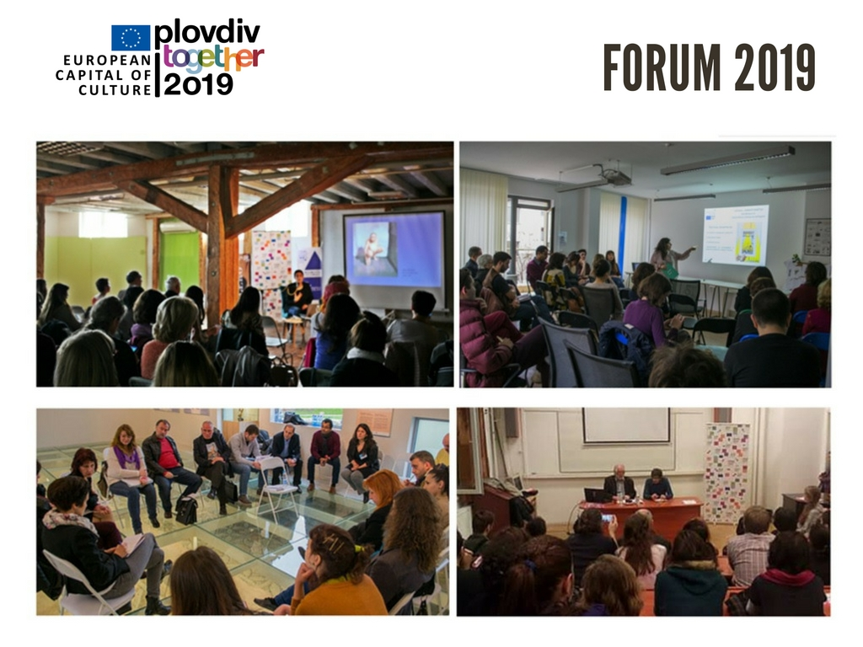
Educational platform that comprises of informational seminars, lectures and meetings under the themes related to the Programme of the European Capital of Culture. The project has stared in 2015 with the idea to provide legacy of the initiative in the transfer of skills, experience and partnerships to the cultural sector. FORUM 2019 aims to create partnership networks for increasing the level of information, to build capacity and to develop audiences.
Since 2015 as of today in the frames of the project there has been more than 30 seminars and training events that have provided knowledge from the basics – what is European Capital of Culture - to practical skills for project proposals preparation and management.
Strategy and Content: The project is a main priority for the activity of Plovdiv 2019 Foundation. The strategy for further development provides enhancement of the level of training events under the project by inviting external experts and specialists in different areas, as well as creating more practical opportunities for networking and direct cooperation of Bulgarian cultural institutions with similar operators from Europe. Part of the project is dedicated to capacity building of the Foundation Plovdiv 2019 team and to enhancement the ability for the big initiative management. This project will be the main practical legacy that the initiative will leave after the year 2019 in developing professionals in the Cultural Management area.
Some of the main project partners so far: America for Bulgaria Foundation, British Council, House of Culture “Boris Hristov”, Cultural Centre of Sofia University “St. Kliment Ohridsky”, Plovdiv University “P. Hilendarski”, AMDFA, Open Arts Foundation, FARA, Galero Furniture showroom, National Library “Ivan Vazov”.
Capacity building and audience development (Horizontal link between all platforms)

Slide 11
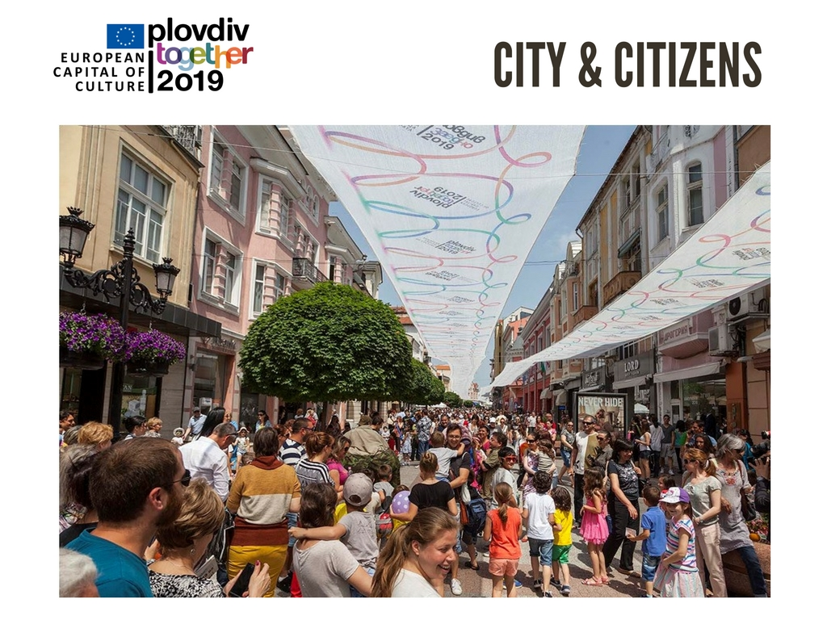

Slide 16
