Slide 1
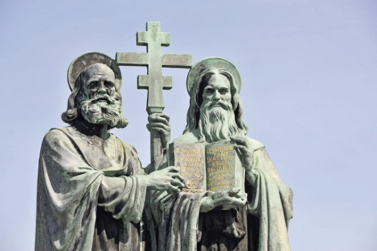
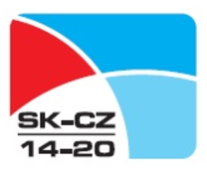
Partnership and Active Institutional Networks of the Cyrillo-Methodian Route in the Moravian-Slovak Border Area (ECRCM)

Slide 2
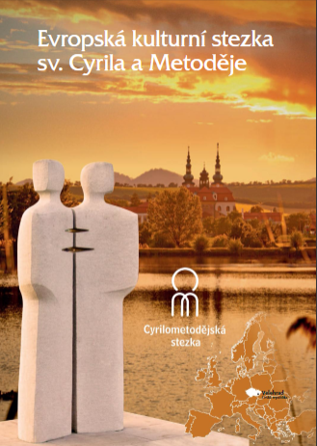
Project Description
Programme INTERREG V-A Slovakia-Czech Republic 2014 – 2020
Priority axis: 3. DEVELOPMENT OF LOCAL INITIATIVES
Investment priority: 5. Promoting legal and administrative cooperation and cooperation between citizens and institutions (11b)
Specific objective: 3.1 Improving quality of cross-border cooperation between local and regional actors
Project name: Partnership and Active Institutional Networks of the Cyrillo-Methodian Route in the Moravian-Slovak Border Area
Budget: EUR 450,000
Applicant: European Cultural Route of St. Cyril and Methodius (ECRCM), an interest association of legal entities
Project partners:
Trnava Self-Governing Region – main cross-border partner
MAS Buchlov, registered association
Nitra Self-Governing Region
Slovak House of Centrope
Mendel University in Brno
Target groups:
Residents of the cross-border region
Employees of local and regional self-governments
Business entities operating in the cross-border region
Project implementation period: 2017-2019

Slide 3
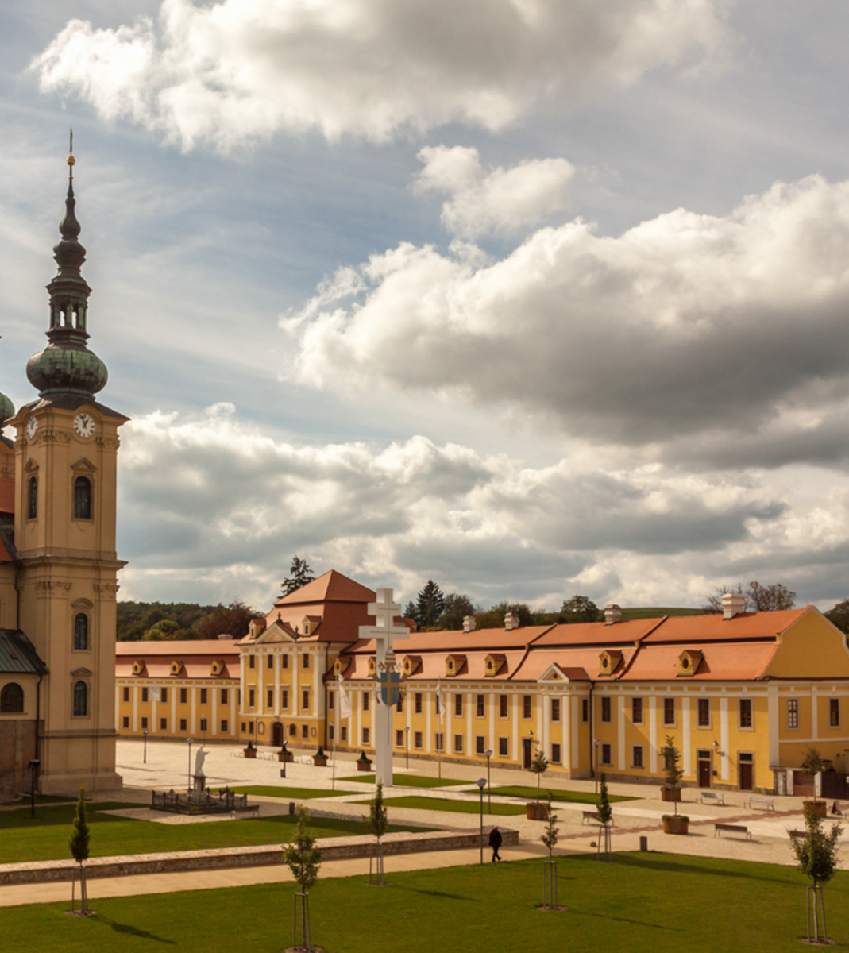
Project Description
Background:
The 1150th anniversary of the arrival of St. Cyril and Methodius (CM) to Great Moravia initiated discussions among the professionals and in media, generating interest in the CM heritage among the general public in the Czech Republic and Slovakia. The celebrations resulted in heightened interest in cultural tourism, involving visits to historical sights associated with Great Moravia and CM heritage.
Although the route has been perceived positively, it faces several problems:
Unclear definition and interpretation of the CM route topic
Absence of the CM Route Development Concept
Insufficient engagement of institutions and poor communication with local entities
Absence of common standards
Elimination of deficiencies through cooperation between key actors and common vision for the cultural development in the cross-border area.

Slide 4
Project Description
The project responds to the needs for introducing a systemic approach to the CM route development. The basis, on which the project is being created, involves cooperation between experts building 3 supporting pillars:
Definition of the route theme in the border area stemming from the cultural and historical heritage of Great Moravia
Elaboration of the CM Route Development Strategy in the Border Area
Strengthening of the CM route’s partners network by adding public and private sector entities
The pilot activities leading to the gradual development of the CM route include incorporation of action plans by partners using bottom-up planning and engagement of local residents, public and private sector.

Slide 5
Project Description
Vision: Creation of the European Cultural Route of St. Cyril and Methodius
Project objectives:
Growth of the sustainable cooperation between the previously non-cooperating institutions and economic appreciation of the common cultural heritage under the CM route brand.
Promotion of innovation, creativity, entrepreneurship, investments and development of cultural tourism products shall contribute to the achievement of common vision of cultural development in the border area under the CM route brand.
The outputs shall form basis for the application for certification of the CM route as a Cultural Route of the Council of Europe.
Sustainability:
Route management based on the cooperation of experts, dissemination of outputs and results throughout the border area, arrangement of a unified approach. The permanent work group shall be responsible for setting up other activities and the CM Route Development Strategy shall serve as the main conceptual document and a tool for expanding the partners network. Engagement of stakeholders in the route development planning.

Slide 6
Project Activities
Project activities:
Analysis of historical and cultural traditions of ECRCM
Determination of ECRCM’s development poles – identification of sites
Identification of important actors, analysis of development potential
Seminars for ECRCM actors
Creation of expert groups at both cross-border and local level
Questionnaire survey
Good practice + study trips
Elaboration of ECRCM Development Strategy – roundtables
Processing of medium-term action plans
Opening and closing conference
Final project publication
Project management

Slide 7
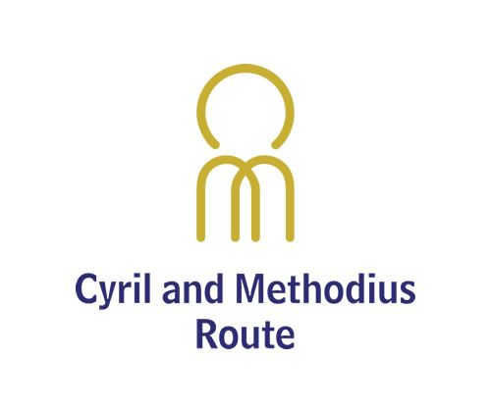
Contact
Organisation: Slovak House of Centrope
Contact person: Ing. Tatiana Mikušová
E-mail: domcentropy@gmail.com
Phone no.: +421 903 826 125
Address: Sabinovská 16, 820 05 Bratislava

